Slide 1
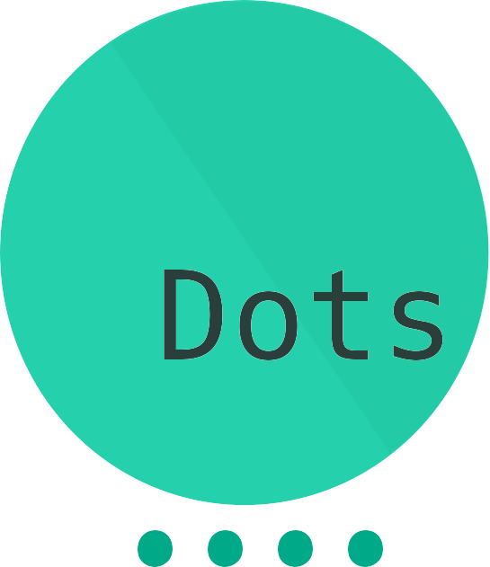

Project Proposal

Slide 2
The challenge was about researchers' struggles while searching for data in multiple resources, and our solution was a more efficient search algorithm that displayed more relevant data by forming connections between expressions and their respective topics during the initial running phases.
The main issue was that the search algorithms used only showed results for the inserted keywords only through a basic search. This, in turn, forced researchers to go through those results themselves to find out what to search up next to get more relevant data. This method proved to be extremely tiring and time consuming, and even confusing for newer researchers.

Slide 3
We looked into the methods being currently used on multiple websites, and most of them composed of the same basic search algorithm mentioned earlier, that only relies on the keywords entered. Other websites used a pre-existing database to identify the related words and topics, but this was not dynamic enough of a solution, unlike ours which adapts the more data it gets.

Slide 4
Our approach to the challenge was to form a vision based on our experience with the topic. After that, we started researching the existing solutions, connecting ideas together and finding ways to overcome their downsides. Then, we started to work on how everything would work exactly, researching some of the most recent search algorithms that suit our application the best. On finishing that, we moved on to testing the reliability and efficiency of the application, which gave us results that even we did not expect.

Slide 5
This application will save researchers all the hassle they go through, looking into files upon files each a couple of gigabytes big at the very least. It will let them find the most relevant data as if the application knew the answers itself. It also makes the whole research process more accessible to everyone, even non-professionals who find joy reading on such topics. One does not need a bachelors degree in a topic to be able to research it with the help of our service, which can even potentially revolutionize self-learning as we know it if more websites start implementing it.

Slide 6
The product itself is a simple online cloud based phone application that lets the user research data from many public resources such as research papers, scientific articles by top universities, and - of course - NASA websites - All that through one search bar. The user is then shown the most relevant paragraphs from each source, with an option to copy the hyperlink to the original article, in case the user is interested in further reading.

Slide 7
The external resources we used were mostly just online scientific articles and research papers, which we turned into a dataset to test our program. The data was, for the most part, gathered from Harvard's website, Nature journal research papers, and NASA partnered websites. Other than that, we used C to code the main application and Flutter for the user interface.
We did not have to buy any product or service during the development of our application.

Slide 8
Ahmed Eltokhy | Team Leader | eltokhy@aucegypt.edu | 01092490965
- Cheif of operations, task organizer.
- Worked in Algorithm Development.
Mohamed Magdi | Data Analyst | moh.magdy.ibrahim@gmail.com | 01141483974
- Data researcher, analyst. Data-Set scraper.
- Video editor, edited the presentation video.
Ibrahim Gohar | App Developer | abdelmaksou@aucegypt.edu | 01093306118
- Developed the Mobile Application using Flutter.
- Adjusted Earth 3D Model to be used in the visualization.
Ahmed Anwar | Back-end Developer | ahmed.rk30@gmail.com | 01148236448
- Algorithm master developer.
- Implemented the back-end features in the application using C.

